Slide 1
Heart disease
By : Ahmed Mohamed salem & Eslam Mohamed.
To : dr. Essam Seddk

Slide 2
The content of presentation :
introduction.
Loading libraries and importing data.
Data cleaning.
Data visualization.
The problems.
The recommended solution.

Slide 3

1 . introduction.
Heart disease is broad term used for diseases and conditions affecting the heart and circulatory system. They are also referred as cardiovascular diseases. It is a major cause of disability all around the world. Since heart is amongst the most vital organs of the body, its diseases affect other organs and part of the body as well. There are several different types and forms of heart diseases. The most common ones cause narrowing or blockage of the coronary arteries, malfunctioning in the valves of the heart, enlargement in the size of heart and several others leading to heart failure and heart attack“.

Slide 4
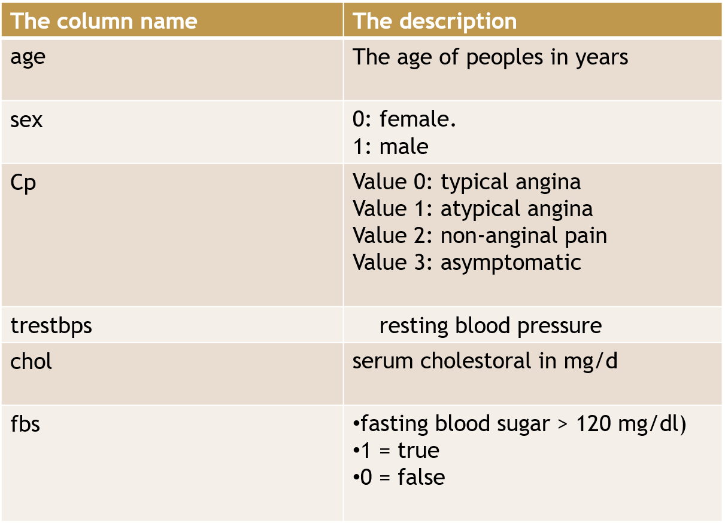
The features of dataset.

Slide 5
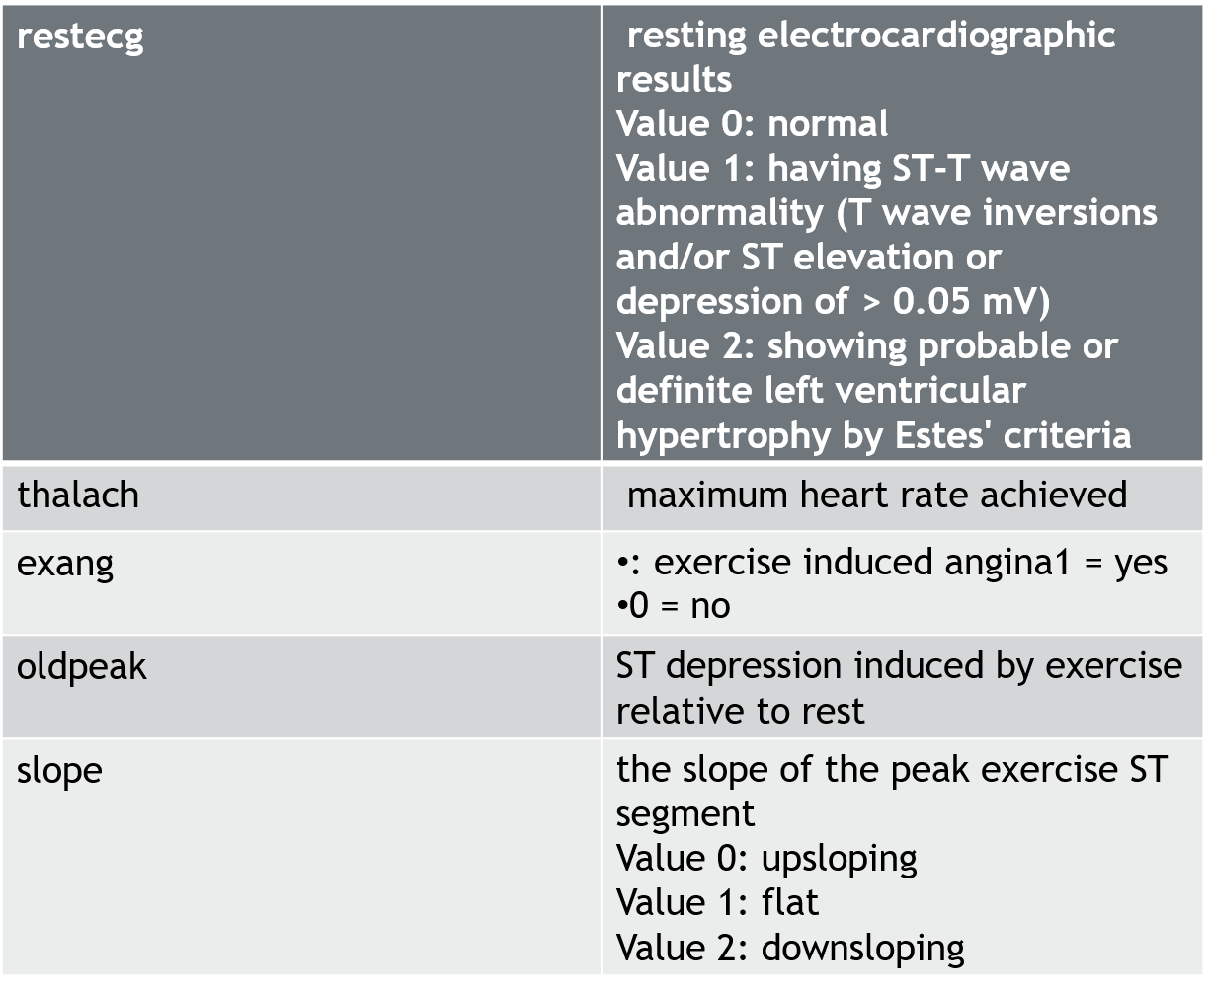

Slide 6
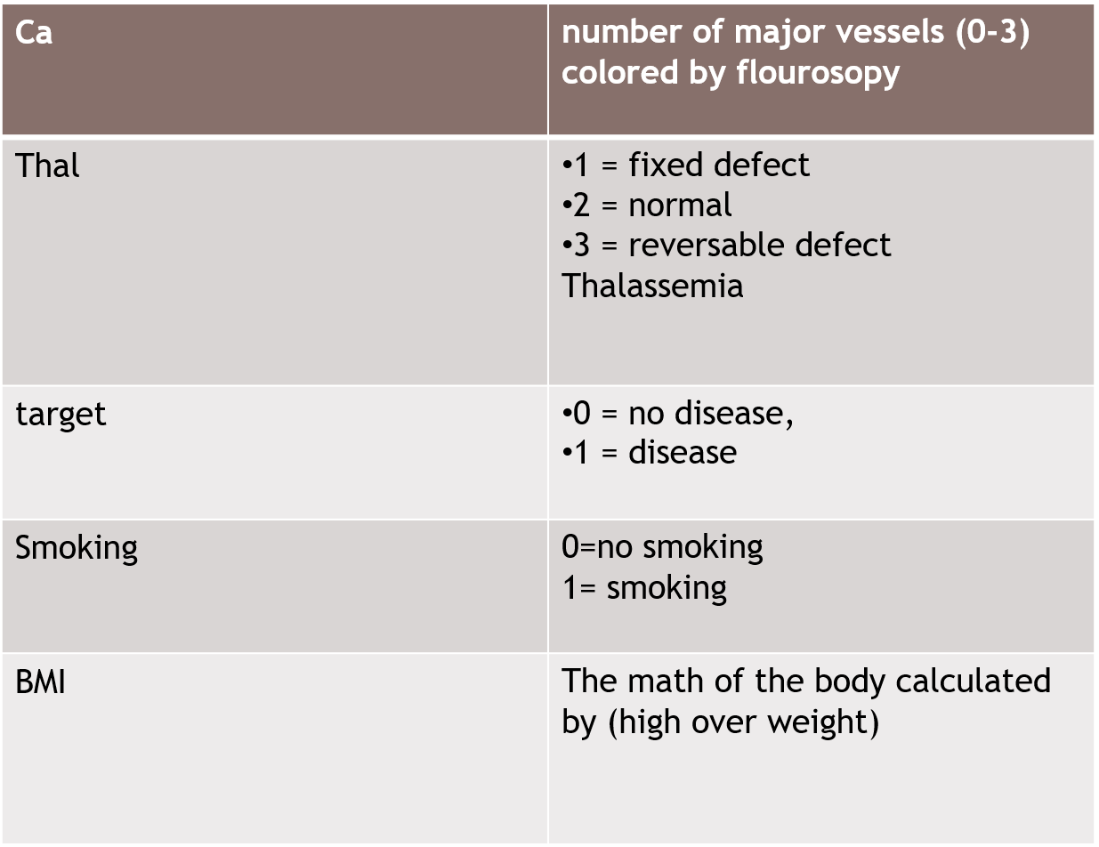

Slide 7
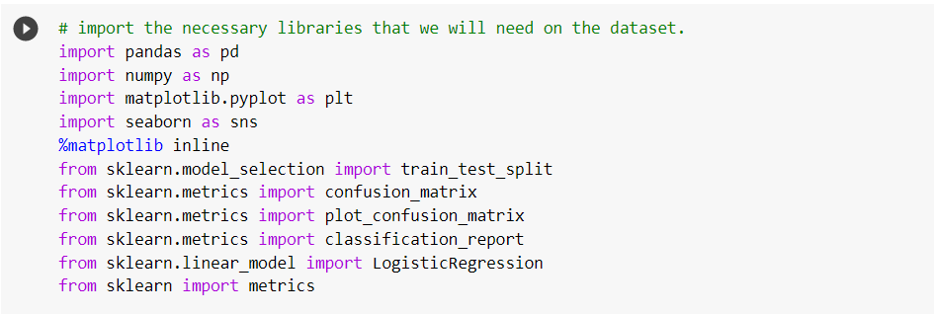
2 . Loading libraries and importing data

Slide 8
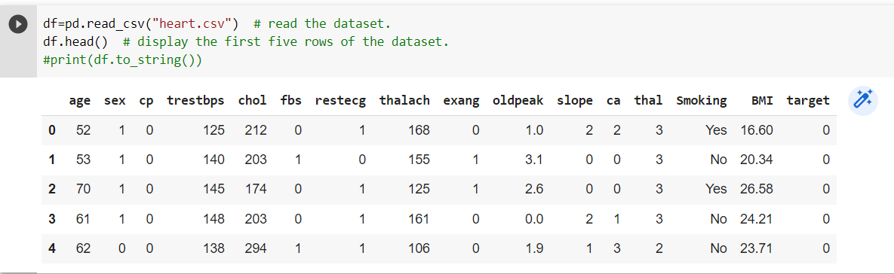
the dataset
We just read the dataset.

Slide 9
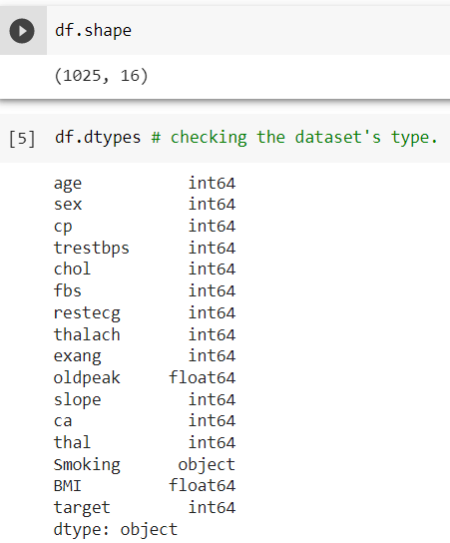
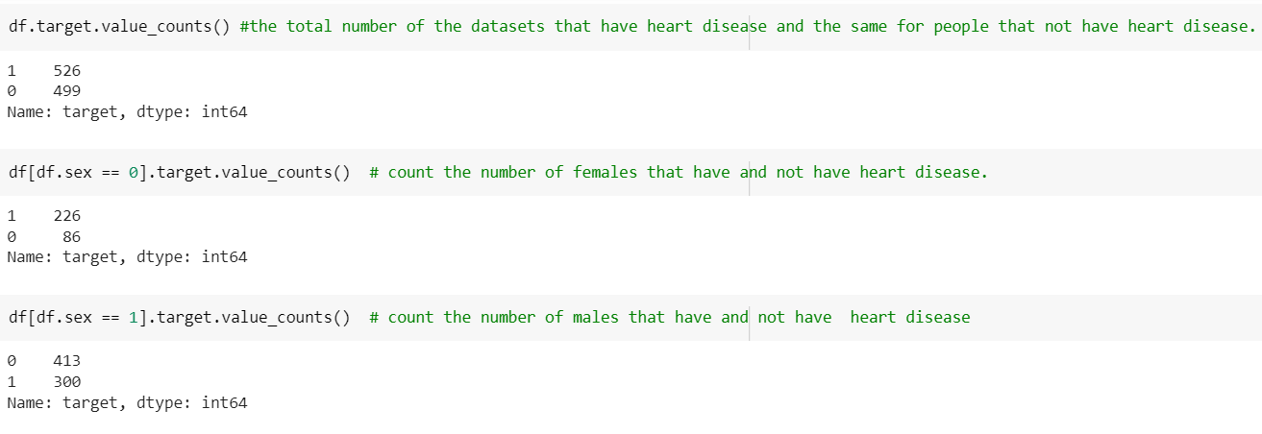
get the shape of the dataset .
checking the dataset's type.
the total number of the datasets that have heart disease and the same for people that not have heart disease.
count the number of females that have and not have heart disease.
count the number of males that have and not have heart disease.

Slide 10
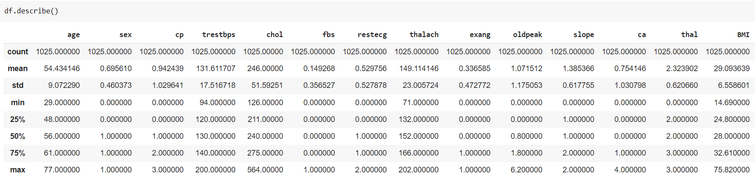
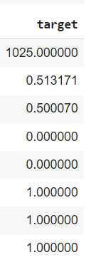
We just describe the datasets to get the mean , count ,std , min and max and other values that can be useful for us.

Slide 11
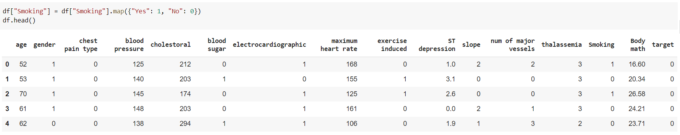
3. Data cleaning.
We convert the categorical variable to numerical and rename some columns to be easy for readers and understandable.

Slide 12
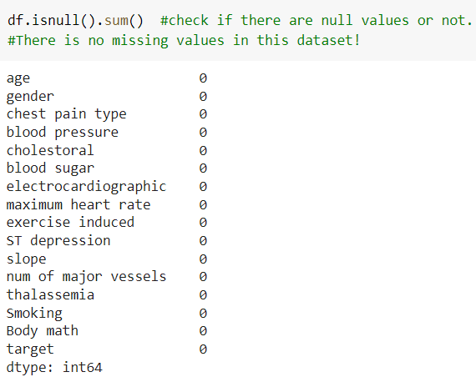
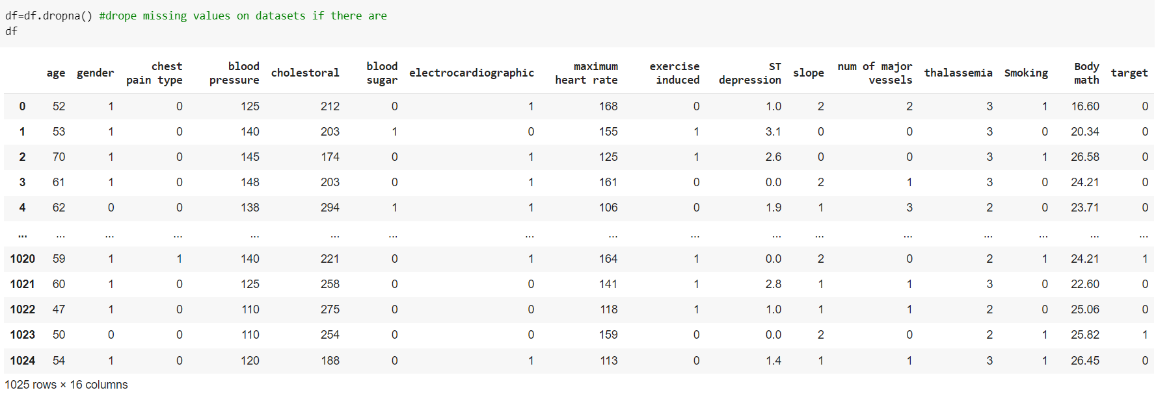
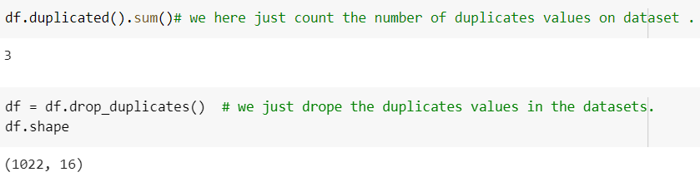
We just check the null values and remove it if is detected and check the duplicates values and drop it also.

Slide 13
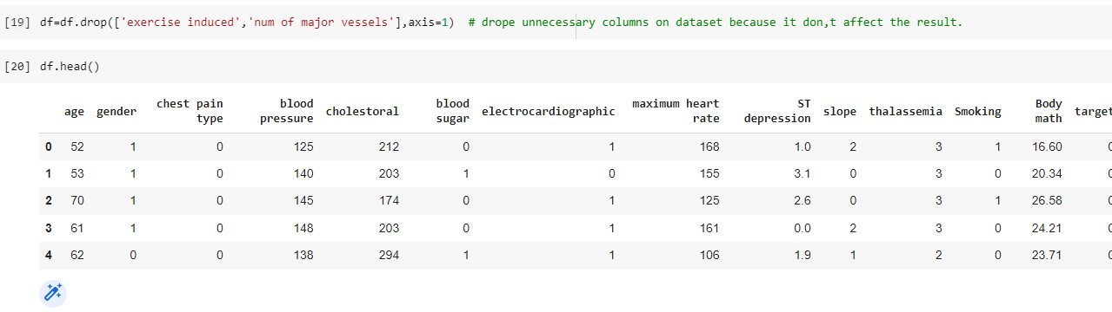
We just drop unnecessary columns that we don't need in our analysis.

Slide 14
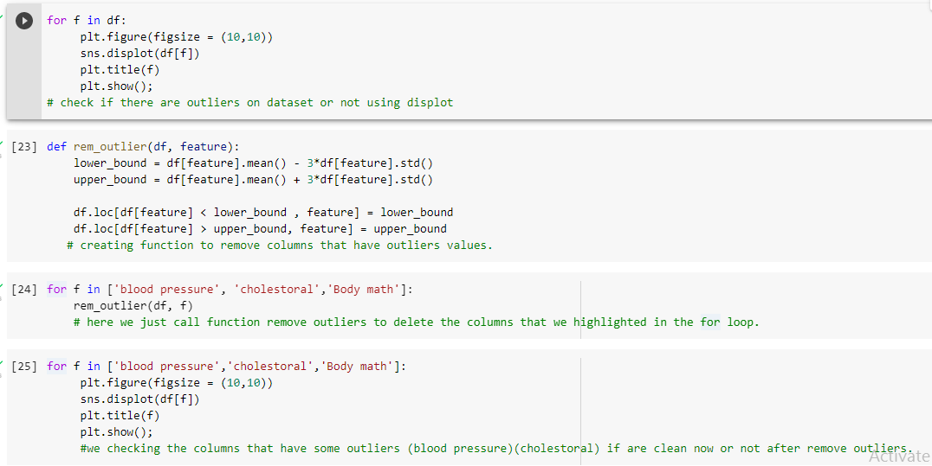
We plot displot to detect if there are outliers in dataset or not and if there are outlier we remove it using function remove and plot displot again to check if the outlier deleted as we want or not.

Slide 15
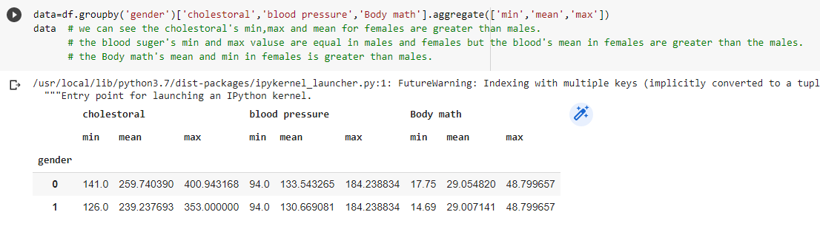
4.Pandas’ aggregate functions
we can see the cholesterol's min , max and mean for females are greater than males.
the blood sugar's min and max values are equal in males and females but the blood's mean in females are greater than the males.
the Body math's mean and min in females is greater than males.

Slide 16
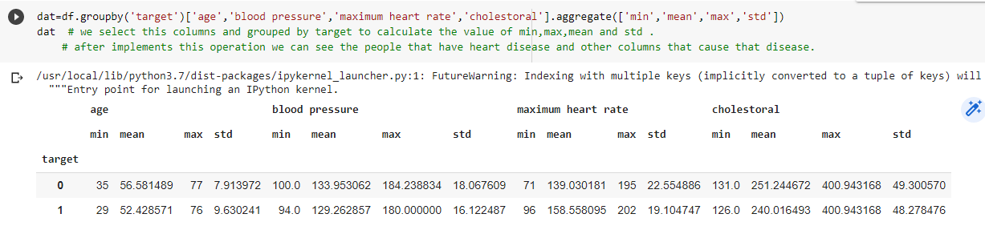
we select this columns and grouped by target to calculate the value of min,max,mean and std .
after implements this operation we can see the people that have heart disease and other columns that cause that disease.

Slide 17
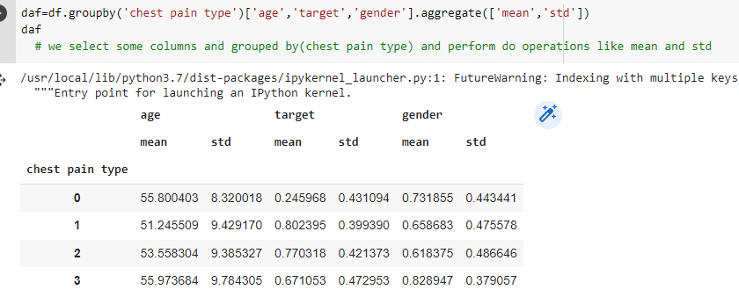
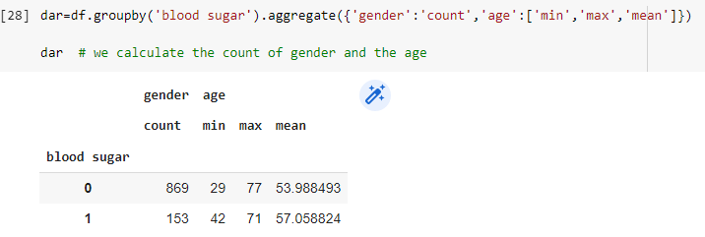
we select some columns and grouped by(chest pain type) and perform do operations like mean and std.
we calculate the count of gender and the age’s min , max and mean grouped by the blood sugar.

Slide 18
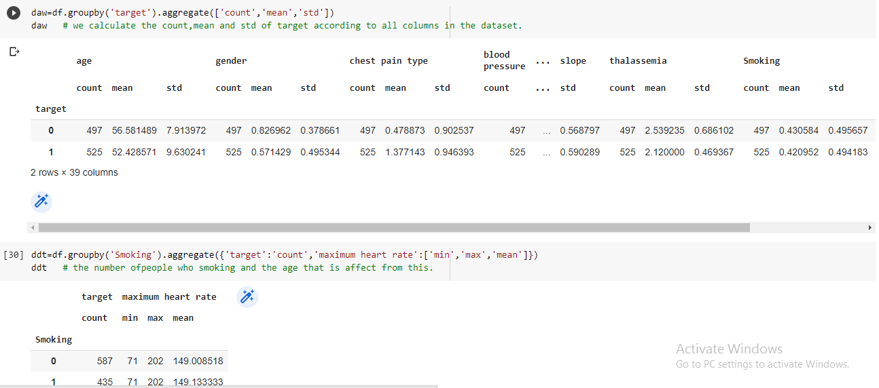
we calculate the count, mean and std of target according to all columns in the dataset.
the number of people who smoking and the age that is affect from this

Slide 19
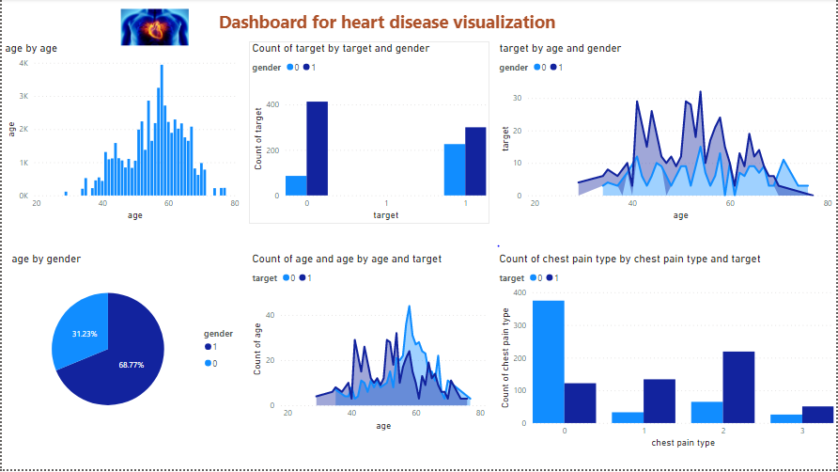
5.Data visualization.

Slide 20
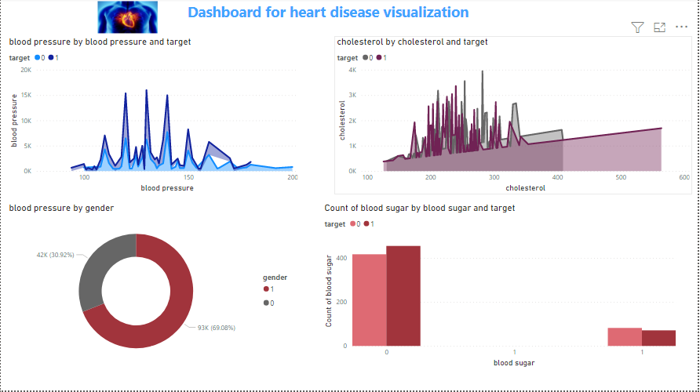

Slide 21
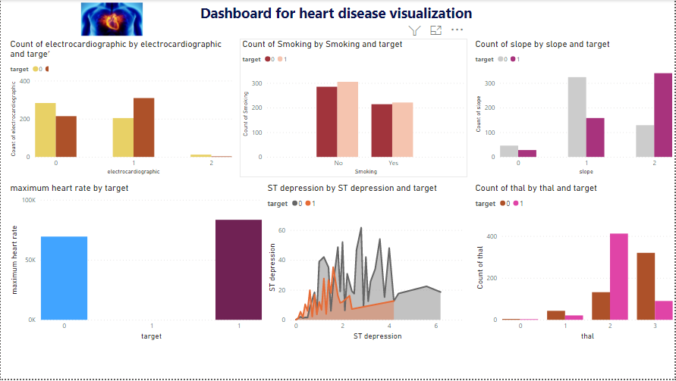

Slide 22
The problems
We can see that most of the people show their heart disease between age 40- more than 60.
We can see that women tend to have more heart disease.
the people who have heart disease is that have chest pain type (atypical angina / non angina pectoris/ asymptomatic) more that the others that don't have.
It seems that people with heart problems generally had slightly lower blood pressure than normal people.
people who have a big cholestoral value is have heart disease.
We see that most of the healthy and sick people have blood sugar less than 120)
Abnormality in electrocardiographic seems to be more dangerous as a lot of sick people have that.
Sick people seem to have higher maximum heart rate values.
We can see many sick people have the kind 2(non typical angina) of Thalassemia.

Slide 23
The recommended solution
the ages: between 40 and 60 should do medical tests periodically to detect if they have heart problem or not.
The chest pain type: The best treatment for your angina depends on the type of angina you have and other factors. If your angina is stable, you might be able to control it with lifestyle changes and medicines. Unstable angina requires immediate treatment in a hospital, which could involve medicines and surgical procedure.
The low blood pressure: Medications>- Several medications can be used to treat low blood pressure that occurs when you stand up (orthostatic hypotension). For example, the drug fludrocortisone, which boosts your blood volume, is often used to treat this form of low blood pressure and (diet and lifestyle changes)
a big cholestoral : by change your lifestyle.
Eat heart-healthy foods.
Exercise on most days of the week and increase your physical activity.
stop smoking.
If lifestyle changes aren't enough we can use medication.

Slide 24
The recommended solution
5. Low blood sugar:
Get physical.
Take your medication as directed.
Follow your diabetes eating plan.
Check your blood sugar.
6. Higher maximum heart rate:
you should avoid:
Stress
fears
Worries
violent efforts
some drugs that cause the higher heart rate.

Slide 25
The recommended solution
7. the thalassemia:
Avoid taking iron tablets and vitamins from nutritional supplements that contain iron without the supervision of a doctor.
Eat a healthy balanced diet.
Taking folic acid to help the body produce red blood cells and taking calcium and vitamin D to maintain bone health.
Pay attention to personal hygiene to avoid infection.
Take a vaccine, such as the flu vaccine.
my code:
https://colab.research.google.com/drive/1kGo_rYWaGdtbrkqti_SIMeP6w9bgvxpO

Slide 26


